Slide 1
Introduction to
Data Structures and Algorithms
Ian Horswill

Slide 2
Introduction to
Data Structures and Algorithms

Slide 3
What do we study when we study algorithms?
We find solutions to computational problems

Slide 4
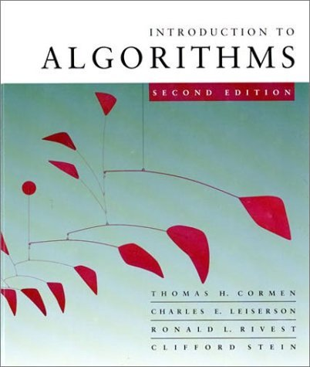
What do we study when we study algorithms?
Problem
  Well-defined input
  Well-defined desired output
Solution (algorithm)
  Description of how to derive the output from the input
  In terms of operations the computer already understands

Slide 5

Example: searching
Input
  A sequence of numbers
  A target number to search for
Output
  Does the sequence contain the number?

Slide 6
Solution 1: brute force
for each number n in sequence
if (n == target)
return true
return false

Slide 7
How fast is it?
Worst case analysis
  Target doesn’t appear in sequence
  Every item tested in sequence
  Execution time is at worst, proportional to length of sequence
  “O(n) time”
for each n in sequence
if (n == target)
return true
return false

Slide 8
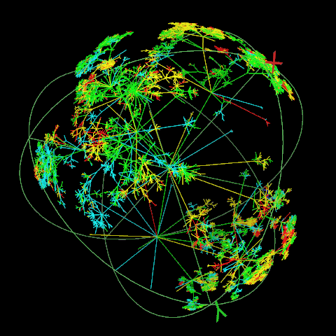
Complexity analysis
Predicting the exact performance of a program is hard
  Different processors
  Different inputs
  Extraneous factors
Focus on how performance degrades for larger inputs
http://www.ima.umn.edu/complex/poster.html

Slide 9
Complexity analysis
Look at how execution time, t(n), grows as a function of the “size” of its input (asymptotic analysis)
Care about whether t(n) is “roughly”
  linear,
  quadratic (n²),
  cubic (n³),
  Exponential
  etc.
What do we mean by “roughly”?

Slide 10
Asymptotic complexity notation
f(n) = O(n²)
  Upper bound
  f(n) is no worse than proportional to n²
  f(n) ≤ kn², for some k and for sufficiently large n
f(n) = Ω(n²)
  Lower bound
  f(n) at least as bad as n²
  f(n) ≥ kn², for some k and for sufficiently large n
f(n) = Θ(n²)
  Tight bound
  f(n) grows as fast as n²
  k₁n² ≥ f(n) ≥ k₂n², for some k₁, k₂, and for sufficiently large n

Slide 11
Asymptotic complexity notation
Ideally, we want solutions that grow linearly, or sublinearly
  i.e. don’t grow any faster than n
Superlinear algorithms are avoided because they don’t scale to large inputs
So
  t(n) = O(1) awesome
  t(n) = O(n) good
  t(n) = O(n²) bad
  t(n) = O(2^{n}) horrific

Slide 12
Great, but does our algorithm actually work?
Simple algorithms seem pretty obvious
  But deciding whether more complex algorithms are correct is a lot harder
So let’s look at some simple tools for proving correctness
Note: this is more a focus of EECS-336

Slide 13
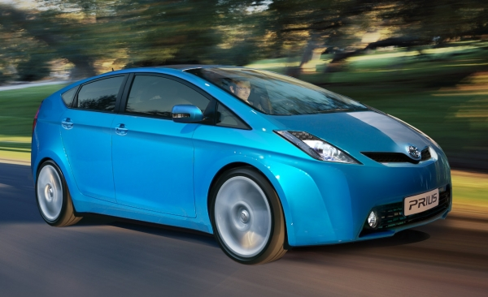
Formal proof
In math and CS, it’s very easy for something to be almost correct
Sometimes the difference between almost correct and correct is important
  E.g. correctness of Toyota brake-control software

Slide 14
Formal proof
Formal proof is when you
  Make an argument for the truth of a proposition
  By starting with agreed upon suppositions
  And conclude the proposition by using agreed upon reasoning steps
http://www.autonorth.ca/home/tag/toyota-prius

Slide 15
Formal proof
Formal proof can be very formal
  Symbolic logic completely mechanical
  Can be automated with computers
Or it can be looser
  Which can make it difficult for beginners to know what “community standards” are
We’ll be less formal in this class

Slide 16
Weak correctness
(if you get an answer, it’s right)
Case 1: it returns true
Then n == target in the last step before returning
But n is chosen from the sequence
So target in sequence
So the result was correct
for each n in sequence
if (n == target)
return true
return false

Slide 17
Weak correctness
(if you get an answer, it’s right)
Case 2: it returns false
Want to show that target can’t be in sequence
Assume otherwise
(i.e. it really is in the sequence)
for each n in sequence
if (n == target)
return true
return false

Slide 18
Weak correctness
(if you get an answer, it’s right)
Case 2: it returns false
Assume it’s in the sequence
  Then the for each loop will eventually get to it in the sequence
  At that point, n == target
  So the if’s test will pass
  And it will return true
  Which contradicts the assumption
  So the assumption must necessarily be false
for each n in sequence
if (n == target)
return true
return false

Slide 19
Weak correctness
(if you get an answer, it’s right)
Case 2: it returns false
  Wanted to show that target can’t be in sequence
  Assumed otherwise
    Contradiction
  So the target can’t have been in the sequence
  So the result (false) was correct
for each n in sequence
if (n == target)
return true
return false

Slide 20
Weak correctness
(if you get an answer, it’s right)
But the algorithm can only return either true or false
  And in both cases, it’s correct
So its return value is correct in all cases
for each n in sequence
if (n == target)
return true
return false

Slide 21
Proving termination
We didn’t technically prove the algorithm is correct
Because we didn’t prove it always returned a result
What if it gets in an infinite loop?
for each n in sequence
if (n == target)
return true
return false

Slide 22
Proving termination
But it’s obvious that it terminates, right?
Yes, but let’s practice proving termination on a nice, simple algorithm before we get into a hard one
for each n in sequence
if (n == target)
return true
return false

Slide 23
Proving termination
Let’s expand the foreach loop into its equivalent for loop
for each n in sequence
if (n == target)
return true
return false

Slide 24
Proving termination
We want to show that the loop terminates
for (i=0; i<length; i++) {
int n = sequence[i];
if (n == target)
return true;
}
return false

Slide 25
Proving termination
For loops terminate when their control conditions are false
So we want to show that i<length will eventually be false
for (i=0; i<length; i++) {
int n = sequence[i];
if (n == target)
return true;
}
return false;

Slide 26
Proving termination
Since i keeps increasing with each iteration
  And always increases by 1
Then no matter how big length is,
  The loop can’t run for more than length steps without terminating
for (i=0; i<length; i++) {
int n = sequence[i];
if (n == target)
return true;
}
return false

Slide 27
enough brute force …

Slide 28
Solution 2: binary search
Assume the numbers in the sequence are sorted into increasing order
Now use this algorithm
  Try the middle of the sequence
  If you found it, great
  If it’s greater than target, you can safely ignore the second half of the sequence
  Otherwise, you can ignore the first half
Each iteration eliminates half the list
?
?
?
?
?
?
?
?
?
?
?
?
?
?
?
!

Slide 29
Divide and conquer
Binary search is an example of a general technique in algorithm design: divide and conquer
  Take a hard problem
  Split it into “easier” problems
  Solve the easier problems
  Combine the solutions
?
?
?
?
?
?
?
?
?
?
?
?
?
?
?
!

Slide 30
Divide and conquer
Take a hard problem (searching the whole sequence)
Split it into “easier” problems (short sequences)
Solve the easier problems
  Search one recursively
  The target can’t occur in the other so we know the answer in advance
Combine the solutions
  In this case, by just taking the answer from the recursive search
?
?
?
?
?
?
?
?
?
?
?
?
?
?
?
!

Slide 31
Pseudocode
Search(target, seq)
int start = 0
int end = seq.length-1
while (start≤end)
int mid = (start+end)/2
if (seq[mid] == target)
return true
else if (seq[mid]>target)
end = mid-1
else
start = mid+1
return false

Slide 32
How fast is it?
Lines in black run once, if at all
Performance dominated by the while loop (green)
Search(target, seq)
int start = 0
int end = seq.length-1
while (start≤end)
int mid = (start+end)/2
if (seq[mid] == target)
return true
else if (seq[mid]>target)
end = mid-1
else
start = mid+1
return false

Slide 33
How fast is it?
How many iterations does the while loop run for?
Search(target, seq)
int start = 0
int end = seq.length-1
while (start≤end)
int mid = (start+end)/2
if (seq[mid] == target)
return true
else if (seq[mid]>target)
end = mid-1
else
start = mid+1
return false

Slide 34
How fast is it?
Hand-wavy analysis:
It terminates if start>end
End-start is cut in half with each iteration
So it can only run for at most log₂(length) iterations
Each iteration takes O(1) time (i.e. it takes no more than a fixed amount of time)
So execution time is O(log₂ n)
Search(target, seq)
int start = 0
int end = seq.length-1
while (start≤end)
int mid = (start+end)/2
if (seq[mid] == target)
return true
else if (seq[mid]>target)
end = mid-1
else
start = mid+1
return false

Slide 35
How fast is it?
Fussy analysis:
Case 1: end=start
  It can only run for one more iteration
Case 2: end>start
  End-start<1 within log₂(end-start) iterations
  But we’re doing integer arithmetic (rounding down)
  So if end-start<1, then end==start
  So end==start within log₂ iterations
  After which we can only run for one more iteration (by case 1)
So we can run for at most log₂(end-start)+1 iterations
Execution time still O(log₂ n)
Search(target, seq)
int start = 0
int end = seq.length-1
while (start≤end)
int mid = (start+end)/2
if (seq[mid] == target)
return true
else if (seq[mid]>target)
end = mid-1
else
start = mid+1
return false

Slide 36
Is O(log n) good?
It’s sure better than O(n)!

Slide 37
But wait!
for each n in sequence
if (n == target)
return true
return false
Search(target, seq)
int start = 0
int end = seq.length-1
while (start≤end)
int mid = (start+end)/2
if (seq[mid] == target)
return true
else if (seq[mid]>target)
end = mid-1
else
start = mid+1
return false
Binary search is doing much more work per iteration!

Slide 38
Uh oh…
Binary search is worse!

Slide 39
Or maybe not …
Binary search still wins for large values of n

Slide 40
Asymptotic performance
O(log n) always beats O(n) for sufficiently large n

Slide 41
What do we study when we study algorithms?
Finding solutions
  How do we solve a problem efficiently?
  Or just: how do we solve it at all?
Evaluating solutions
  How efficient is a given solution?
  (algorithmic complexity)
  Can we do better?
  (looking for lower bounds)
  How do we even know it’s a solution?
  (proving correctness)
Forming a general theory
  What are some reusable techniques for solving problems?
  What problems are harder than others, and why?
    Are there problems that are inherently insoluble?
    Are there problems that are inherently expensive?

Slide 42
But wait!
When we did binary search
  We assumed the sequence was presorted
  We implicitly assumed it was an array
What if it was a linked list?
Getting the nth element of a linked list always takes n steps
So seq[n] takes O(n) time all by itself!

Slide 43
But wait!
If seq is a linked list, then we still have to run O(log n) iterations of the loop
But now each iteration takes O(n) time
So the algorithm takes
O(n log n) time
Search(target, seq)
int start = 0
int end = seq.length-1
while (start≤end)
int mid = (start+end)/2
if (seq[mid] == target)
return true
else if (seq[mid]>target)
end = mid-1
else
start = mid+1
return false

Slide 44
Brute force doesn’t look so bad now …
O(n) stomps O(n log n)

Slide 45
Data structures matter
How your data is represented has a huge impact on how efficiently you can process it
Searching for an item
  Sorted array ⇒ binary search ⇒ O(log n)
  Linked list ⇒ brute force ⇒ O(n)
Adding an item
  Sorted array ⇒ recopy elements to make room in the middle of the array ⇒ O(n)
  Linked list ⇒ stick it at the beginning ⇒ O(1)

Slide 46
Introduction to
Data Structures and Algorithms

Slide 47
Introduction to
Data Structures for Algorithms

Slide 48
administrivia

Slide 49
Teaching staff
Instructor: Ian Horswil, ian@northwestern.edu
Mudd 3537
Office hours: WF5pm
TAs
  Office hours: Mudd 3538
    Generally 2-6pm
    See link in syllabus for specific schedule
  Grad TA: Will Hancock wwhancock@u.northwestern.edu
  Peer mentors: Haishan Gao, Paul Farcasanu, Amy Yang, Rohaan Advani, May Li, Melissa Renae Perez, Beth Mallon, Caryl Henry

Slide 50
Prerequisites
EECS-111
  You will need to be comfortable with recursion
  This is really important
  We won’t be using Racket, but we’ll be writing code that is more 111-like than 211-like
EECS-211
  You will need to be comfortable with C-style languages and using the debugger

Slide 51
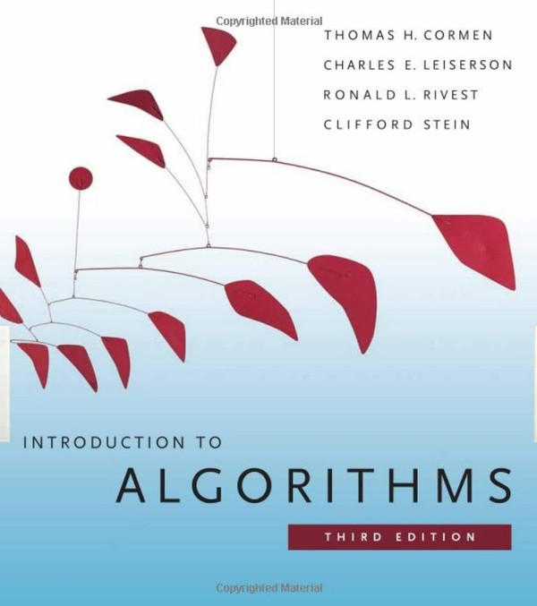
Optional text
Cormen et al.,
Introduction to Algorithms, 3rd edition
MIT Press

Slide 52
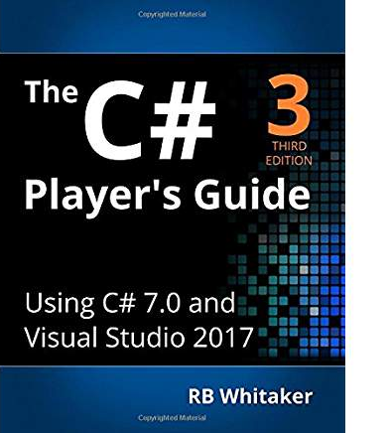
Optional text
Any C# book, such as …
RB Whitaker,
The C# Player’s Guide, 3rd Ed

Slide 53
Grading
40% assignments
  Mostly programming assignments
  Most people will get A’s on most assignments, so don’t infer anything from that about your final grade
10% microquizzes
  Weekly 5 min quizzes given in TA session
  Graded check/+/-
50% quizzes
  3 one-hour quizzes
  First two in class
  Last one in finals slot
  (Monday, June 10, 9-11am)

Slide 54
Final exam conflicts
If you have an internship that precludes you attending during finals week
We can’t give you an early exam (Northwestern policy)
But we’re happy to give you an incomplete and let you make it up in the fall
  Note that Weinberg students require Dean’s approval for this
If your company offers a proctoring service, then we can also work with them
  You would however need to take the exam simultaneously with the rest of the class

Slide 55
Software and programming language
Language: C#
Software (free)
  Visual Studio Community 2017
    Windows-only
    Upgrade if you’re still running 2015; assignment may not run in 2015
    Also available on the machines in the Wilkerson Lab (Tech M338)
    Visual Studio for Mac will not work
  Microsoft Windows
    Free to CS students
    We’ll post instructions this week on dual-booting your Macs
  ReSharper
    Not available in the labs ☹
    But you really really really want to use it if you’re working on your own machine

Slide 56
Programming assignments
Roughly one per week, starting next week
Machine graded using automated testing features in Visual Studio
  Grade is proportional to number of unit tests that pass
You’re responsible for writing unit tests
  We won’t publish the ones we’ll use for grading
  So use the ReSharper coverage analyzer to make sure you’re testing everything!

Slide 57
Late policy
You may have a 48 hour extension for any problem set, no questions asked, provided you request it at least 24 hours before the assignment is due
  A web form will be provided along with your assignment
If you don’t register for an extension or if you overrun the extension, you will receive a 30% late penalty
Assignments more than one week late will not be accepted except in extenuating circumstances

Slide 58
Cheating policy
You are free to ask other people for help, however
No one else may edit your code
You may not copy code from other people
You may not distribute your code to others
Students suspected of violating this policy will be reported to the Dean for investigation
Uploading materials from this course to websites that sell such content to students is prohibited by Northwestern’s academic integrity policies, and may also put you at risk for violating copyright policies in Northwestern’s Student Conduct Code.
In other words:
Hacking parties are good
Asking friends questions about assignments is good
Copying part of someone’s assignment is forbidden
Giving your assignment to someone to copy is forbidden
Having three people do one assignment together is forbidden
Publishing your assignment on github is forbidden

Slide 59
Seriously: don’t cheat
We will be enforcing this quite stringently

Slide 60
Why you should use C#
Very similar to C++
  Short learning curve
Simpler
  Everything is an object
  No .h files
  Declaration order doesn’t matter
  Automatic storage management (GC)
You don’t have to write
  Destructors
  (Some) type declarations
You can’t
  Corrupt memory
  Leak memory
  Use a null pointer without the system noticing
  Have an undetected buffer overflow
You can do
  Functional programming
    Mmm…. λ...
  Reflection
  Multithreading
  Asynchonous calls to servers and other threads

Slide 61
Tentative schedule by week
Intro, discrete math, C#
Abstract data types, fundamental data structures
Trees
Search trees
Hash tables
Graphs
Graph algorithms
Priority queues, sorting
Sets
Finals week
Quiz 3, Monday, June 10, 9am
:-(
Same length as Q1, Q2
But you can take the full 2 hours if you want

Slide 62
FAQ
Q: I don’t know C#. Is that a problem?
A: No. Almost none of you know it. But it’s easy to pick up. I’ve yet to have a student say they would have preferred C++.
Q: Do I have to use windows?
A: Yes; sorry. It’s the only platform Visual Studio runs on. But both windows and Visual Studio are free. And VS is excellent.
Q: I’m a Mac or Linux user. What do I do?
A: Either:
  Dual boot your system (Mac users use Bootcamp)
  Run windows in a virtual machine
    Windows then looks like an application inside of MacOS/Linux
    I use Parallels Desktop for Mac ($40 for the student license)
    But you can also use VMWare Fusion ($80) or VirtualBox (free)

Slide 63
For this week
No discussion sections
  Sections will start next week
Install Visual Studio Community 2017
  Upgrade if you have 2015
Install ReSharper
  Free, but you have to apply for a license and wait to hear back
Optional
  Read Whitaker, parts 2,3 and chapters 27 and 37

